Slide 1
AADD Strategic Plan Updates

Slide 2
2016-2018 Strategic Plan Review
Goal #1: Develop a comprehensive advocacy and communication strategy to maintain sustainability of our system Increase legislative presence with the intent of providing education and information regarding the business of providing services, and assist with its dissemination to recipients and families. Coordinate advocacy efforts with the Key Coalition, the Governor’s Council and the Community Care Coalition. Expand the voice of Alaskan providers to national level. Goal #2: Expand workforce capacity within the developmental disability system Support the development of emerging leaders and programs through peer mentoring, job shadowing and professional development events. Identify shared/collaborative training opportunities, regionally and statewide. Develop meaningful workforce support for rural and remote community providers. Goal #3: Increase AADD’s sustainability Strengthen board of directors through strategic recruitment and development activities. Increase membership including outreach to rural/remote Native communities and care coordination agencies. Research other association models. Explore revenue-generating opportunities such as publications or services.

Slide 3
2019-2021 Strategic Plan Goals
Goal #1: Develop an implementation strategy for the Shared Vision which strengthens the sustainability of our system Increase advocacy, education and information regarding the business of providing services, and the promotion of the Shared Vision through simplicity, flexibility and contributing to meaningful lives for recipients and families. Expand advocacy efforts with other Shared Vision stakeholders including the Alaska Mental Health Trust Authority, the Governor’s Council on Disabilities and Special Education, Individual and Family Advocacy groups, and related Trade Associations. Maintain the voice of Alaskan providers at a national level. Goal #2: Retain and develop a professional workforce within the developmental disability system Support the development of supervisory and managerial competency in knowledge, skills and abilities to improve retention of Direct Service Professionals. Promotion of integrity and quality improvement of meaningful services which support for value based reimbursement for providers and their employees, including care coordination services. Identify workforce support strategies relevant to rural and remote community providers. Identify shared/collaborative training opportunities, regionally and statewide. Goal #3: Enhance AADD membership for future system change Development of Best Practices for DD services, promoting the AADD website reference resource Promotion of transitions from Institutional to Community Based Care through collaboration with other services Strengthen board of directors through strategic recruitment and development activities. Promotion of membership from rural/remote Native communities and care coordination agencies

Slide 4
2019 Action Priorities
Priority #1: Implementation Strategies for Shared Vision. Action Steps: Communicate provider issues with State including: Flexibility & simplicity of systems, which promote choice and self-directed services Obtaining clarity on regulatory and conditions of participation, with intent language and examples of their application Concerns about the DD registry rating process and how draws are determined The need for non-habilitation companion type services as an alternative or to complement habilitation-only services Monitoring continued impact and Service Delivery of Individual Supports Waiver implementation to replace CDDG grants. Expand networking and advocacy alignment with the Key Coalition of Alaska, Peer Power, the Alaska Behavioral Health Association, Agenet, and the Alaska Personal Care Services Association

Slide 5
2019 Action Priorities
Priority #2: Develop and Retain a Professional Workforce. Action Steps: Collaborate with the Foraker Group on offering a Supervisory and Managerial training to emerging leaders across the State of Alaska. Participate in the development of a system of support for Care Coordinators to promote a unified voice. Support the Shared Vision workforce development focus in achieving shared/collaborative training and advancing “ready-to-work” initiatives for Direct Service Providers. Priority #3: Enhance AADD membership preparedness for future system change Action Steps: Improvement and promotion of the AADD website as a reference resource Development of service delivery reporting practices that equip providers to qualify for value based reimbursement methodologies Actively engage in multi-disciplinary planning teams focused on successful transition of individuals from Institutional to Community Based Services.

Slide 6
Understanding State of Alaska Budget: Allocations within an Appropriation

Slide 7
2018 SDS Report

Slide 8
State of Alaska FY20 Budget….so far!
02/25/19 Governor’s Budget (OMB) Medicaid Services reduction of $714M to cut State GF by $249M: eliminated adult dental & combined Behavioral Health, Health Care, & SDS services into one allocation
03/27/19 DHSS presentation to House Finance Committee Medicaid Services reduction of $187M to cut State GF by $102.9M, including provider rate reductions by 5% in Phase One

Slide 9
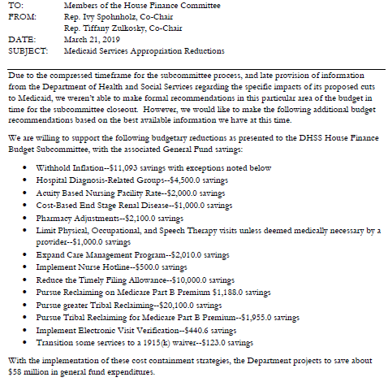
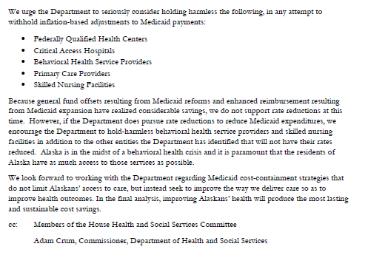
State of Alaska FY20 Budget….so far!
House Finance Committee passed budget with $58M cuts to State GF:

Slide 10
Now it’s with the Senate…
Advocate for SDS Medicaid services to be added to the “hold harmless” list as vulnerable Alaskans, with separate appropriation
Refute the “extra $50M” claim from OMB that a separate appropriation would require
Educate on why Federal block grants do not advance Medicaid reform efforts in progress

Slide 11
Thank you!
We appreciate your active membership, and participation in the activities of the Association.
We are here to support you!!
Remember our website
www.alaskaaadd.org

